Slide 1
Final Presentations (Week 14)
You will give a demonstration of your visualization in action for your classmates during the discussion section. Like the mid-term presentations, you will have 15 minutes.
This demonstration is your chance to show your fellow students how far your design has come since the mid-term milestone. Tell us what you changed and why.
You must include details and conclusions from at least one round of usability testing (with at least three different subjects).Tell how your design changed (or will change) in response to your findings.
Also address your choice of tools for building the final interactive visualization
All team members must participate in the presentation.
Grading Rubric for Final Project (not just presentation)
Your instructor will consider the final presentations, the web site, and any additional information you provide in the final paper in determining a single grade for the final project.
12 points - Is the final product of appropriate form?
12 points - Does it successfully solve a problem or inform the user?
12 points - Is the explanatory text clear?
12 points - Did you show substantial iteration?
10 points - Can the visualization be understood without too much effort?
10 points - Is it aesthetically pleasing?
10 points - Did you include results of usability testing?
8 points - Did you present data in a novel way?
8 points - Did you explain your choice of tools?
6 points - Did everyone in your group participate?

Slide 2
Outline for the final presentation
Project Objective and Target Users (2 mins)
what our project is about
target users
Our progress as of mid-term
Technology stack (and rationale) used to create end product (2 mins)
Balsamiq for mockups
Highcharts
Flask
Pythonanywhere to host
Usability testing and prioritized changes (5 mins)
Users we talked to
What we learned (details) and corresponding changes (conclusions) we made (5 mins)
Show old version (from mid-term) with callouts showing what we changed)
Demo of our visualization (6 mins)
3 mins for each visualization

Slide 3
Insight@ADP Visualizing ADP’s National Employment Report
Saad Padela, Roiana Reid, Amin Venjara
August 11, 2016

Slide 4




Roadmap for our presentation
Project Objective and
Target Users
AV
Technology Choices
SP
Usability Testing and Learnings
AV/ RR
Updated Visualization
SP/ RR

Slide 5

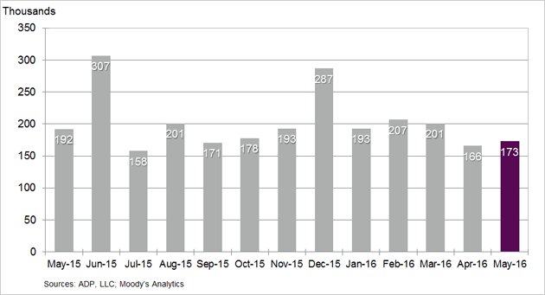
A quick reminder about our project Current state of the NER and our objective
Objective
Current State of the
National Employment Report
Project Objective
The National Employment Report (NER) is an estimate of total US employment produced monthly by ADP, a payroll service provider
1 in every 6 working Americans is paid via ADP (24 million workers)
Explore new and interactive ways for users to engage with the NER data and easily consume the economic insights that emerge from them via 2 angles:
Jobs Explorer
Allow users to explore the different dimensions of the National Employment Report via an intuitive and flexible visualization.
Change in Nonfarm Private Employment
Bureau of Labor Statistics (BLS) Comparison
Enable users to understand the power of the ADP employment data in predicting the Bureau of Labor Statistics employment data.

Slide 6
Business journalists and financial professionals are our target audience
Objective
Priority | Segment | Likelihood to visit | Need from Data | Visualization Need
Target Users | Business Journalists | High (need to deliver timely business insight to a general audience) | Want to report the most recent numbers Statistics to support a current story Background to inform a potential story | Communicative Make it simple to understand trends Give me a visual to support my story
 | Economists / Financial professionals | Medium / High (likely to get data from Bloomberg or aggregating data source) | Most recent data to inform economic models Investigate predictors to help forecast market movements | Exploratory Give me the raw data, so I can play with it myself Help me see trends to inform my own hypotheses
Potential future focus | Students | Medium (awareness of ADP report may be low) | Input to a exploratory model or a paper related to labor / economic concerns | Exploratory Make it easy for me to tailor data to my project
 | Policy makers | Medium (tend to favor official government data) | Context and supporting data for proposed legislation | Communicative Make it easy for me to see trends relative to my constituents
 | Small businesses | Low (busy running their businesses) | Put their own experience in context of the broader economy | Communicative Help me understand how I relate to businesses like me

Slide 7
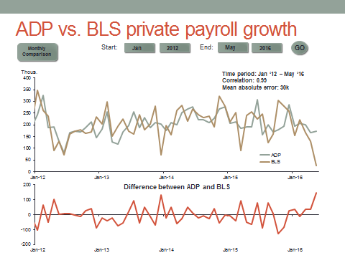
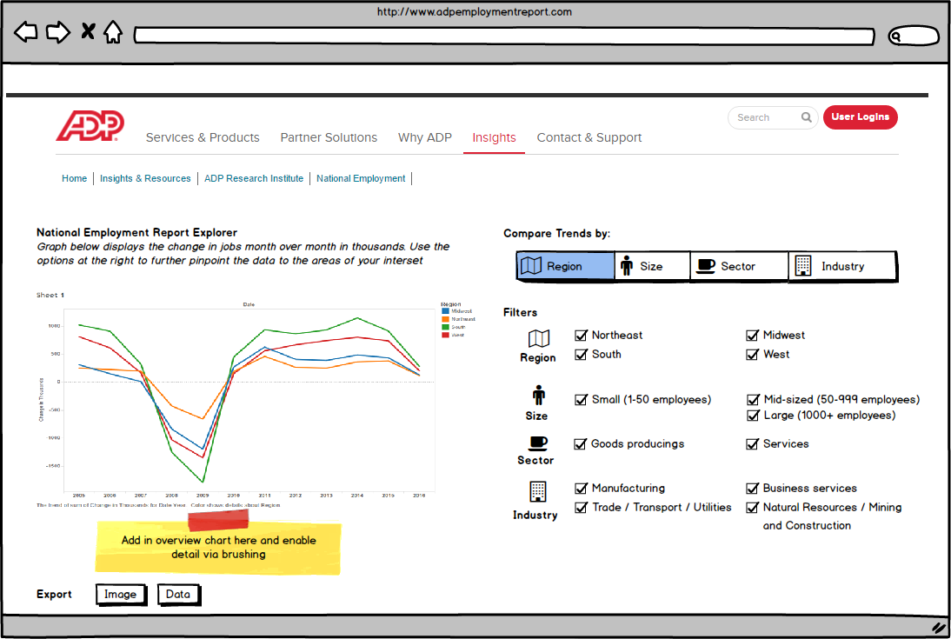
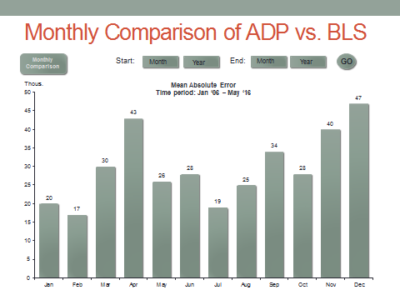
Where we left off as of the mid-term Design mockups
Objective
Jobs Explorer
BLS Comparison

Slide 8

A few technology choices were fundamental to building our final visualization
Technology
SP
Function |  | Technology |  | Rationale
Visualization |  | Highcharts |  | Simple, clean aesthetic with lots of interactive features Well-chosen default settings, but configurable. Lots of functionality out-of-the-box Pure javascript, easy to deploy with just a few files Data is passed as JSON objects
Data Manipulation |  | Python (Pandas) + Flask |  | Able to use the full functionality of pandas to import, manipulate, and aggregate the source data Flask acts as the gatekeeper (controller) for the application, intercepting urls and button clicks Conditional logic can be written in Python instead of Javascript, which was a better fit for our skill set
Hosting |  | PythonAnywhere |  | Configuring AWS instances proved too time-consuming PythonAnywhere has a very easy setup for Python/Flask. Incorporating Highcharts just meant importing some javascript files.

Slide 9

Who we talked to
UX Testing
AV / RR
Jobs Explorer
ADP/BLS
Initial Discussions with:
- US Economist
- Global Macro Strategist
- Interest Rate Strategist
Main Takeaways: 1) Main use of ADP is to predict the BLS payrolls estimate. 2) Useful to know how the difference between the ADP and BLS estimates changes over time.
User Testing:
- Global Macro Strategist
Main Takeaway: The visualization comparing the difference between the ADP and BLS payroll estimates by month was deemed most useful.

Slide 10
Testing uncovered a number changes (I) Jobs Explorer MoSCoW prioritization
UX Testing
Priority |  | Issue |  | Potential Solutions
Must Have |  | Users are confused by the discrepancy between the full date in the tooltip and the x-axis label that is a month ahead. Leads to "off-by-one" error when trying to select a data point |  | Update the tooltip date format so that it only shows month, not full date Change the date format so that change in jobs is aligned to the beginning of the month
 |  | User was confused by filtering functionality. Functioning of the check boxes vs. what was displayed on graph did not correspond to expectation |  | Fix the alignment of the compare buttons and filters check boxes Remove / Grey out the filter check boxes when its 'Compare Trends by :' button is checked (i.e., grey out Goods and Services check boxes when Sector is clicked) Have more descriptive text on what it does (e.g., "Aggregate the sector data by:“
Should Have |  | Users do not notice the overview chart. Do not have an intuitive sense of how to use it |  | Change the default time period from all to 1 year so that the blue region is more narrow Add a hover element to call attention to the overview functionality when the page loads for the first time
 |  | Confusion because the 1m and 3m zoom options are greyed out |  | Get rid of 1m, 3m filter boxes
Could Have |  | Users don't have a good sense of what Filtering categories are composed of (e.g., Northeast, Services) |  | Add in the information buttons to have greater detail on what the data elements are
 |  | For US users, date entry format is awkward (YYYY-MM-DD) |  | Change the way dates are entered in the top right date entry box -- MM-DD-YYYY when you select the box
Won’t Have |  | Company size button was not enabled |  | Leave out company size implementation until a later phase. It is more important to get the cuts we have easily usable, rather than adding more functionality.

Slide 11
Testing uncovered a number changes (II) BLS Comparison MoSCoW prioritization
UX Testing
Priority |  | Issue |  | Potential Solutions
Must Have |  | When the user entered dates to generate new time series line charts, the new charts were appended below the original charts. The user expected the original charts to be removed and replaced with new charts. |  | When new dates are entered, ensure that the original charts are removed first in order to prevent refreshed chart from being appended below the original chart.
 |  | The user was unaware that the synchronized time series plots consisted of two charts. |  | Reduce the size of each time series chart to ensure that they both fit on one page and that the user identifies both synchronized charts .
 |  | The user seemed to take too long to identify the forms where he needed to enter dates in order to generate the visualizations and was unsure about what exactly the visualizations would display. |  | Automatically load charts whenever the page is loaded, to enable the user to easily determine the aim of the visualization and allow for easier manipulation. Label charts more clearly and provide more detailed explanations for visualizations.
Should Have |  | On the synchronized time series line charts, the tooltip for one of the series was missing. |  | Fix the code to ensure that the tooltips for all series are displayed without affecting the synchronizing functionality of the time series visualization.
Could Have |  | The user suggested displaying whether or not a positive or negative bias is associated with the difference between ADP and BLS estimates for each month. |  | On the column chart, display the count for the number of times the ADP was above or below the BLS estimate over the relevant time period in the tooltip for each month’s data .
Won’t Have |  | The user suggested a zoom option for the time series charts. |  | At present, this is not a feasible change, as the date entry forms are used to perform calculations such as the correlation and mean absolute error over the specified time period.

Slide 12

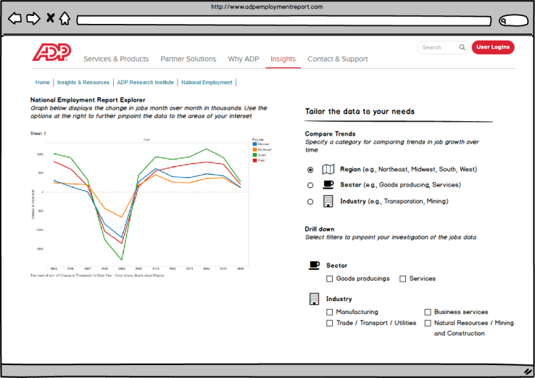
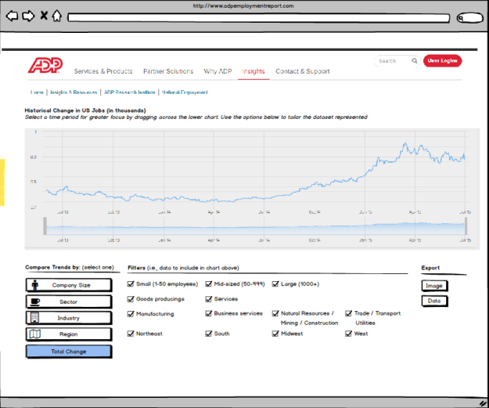
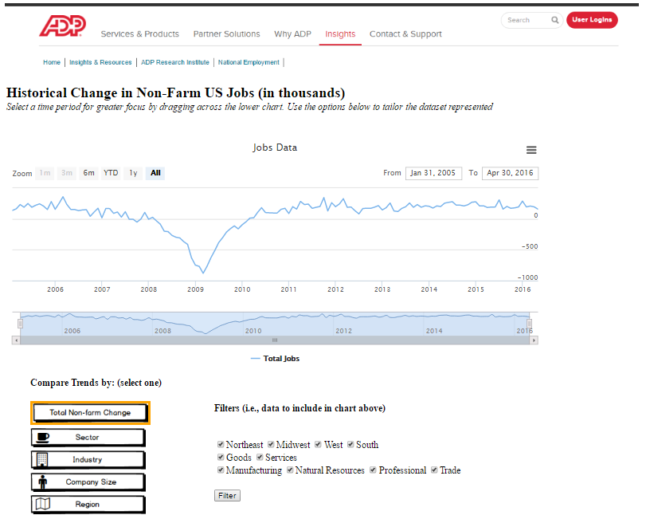
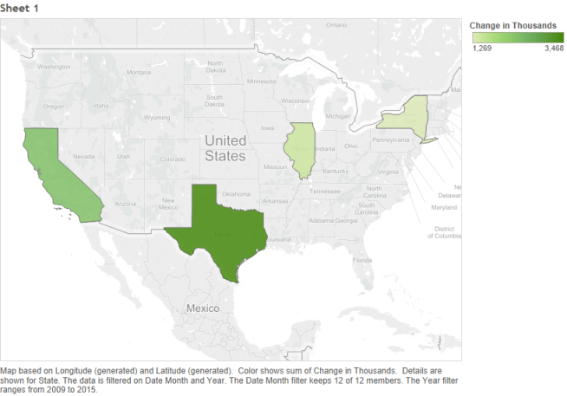
Based on user testing, we made multiple iterations on our visualizations (I) Jobs Explorer

Slide 13
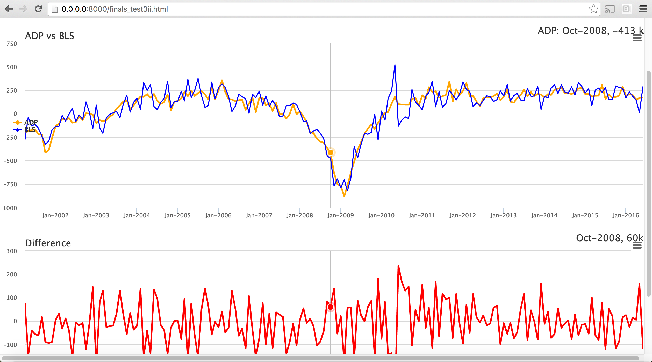
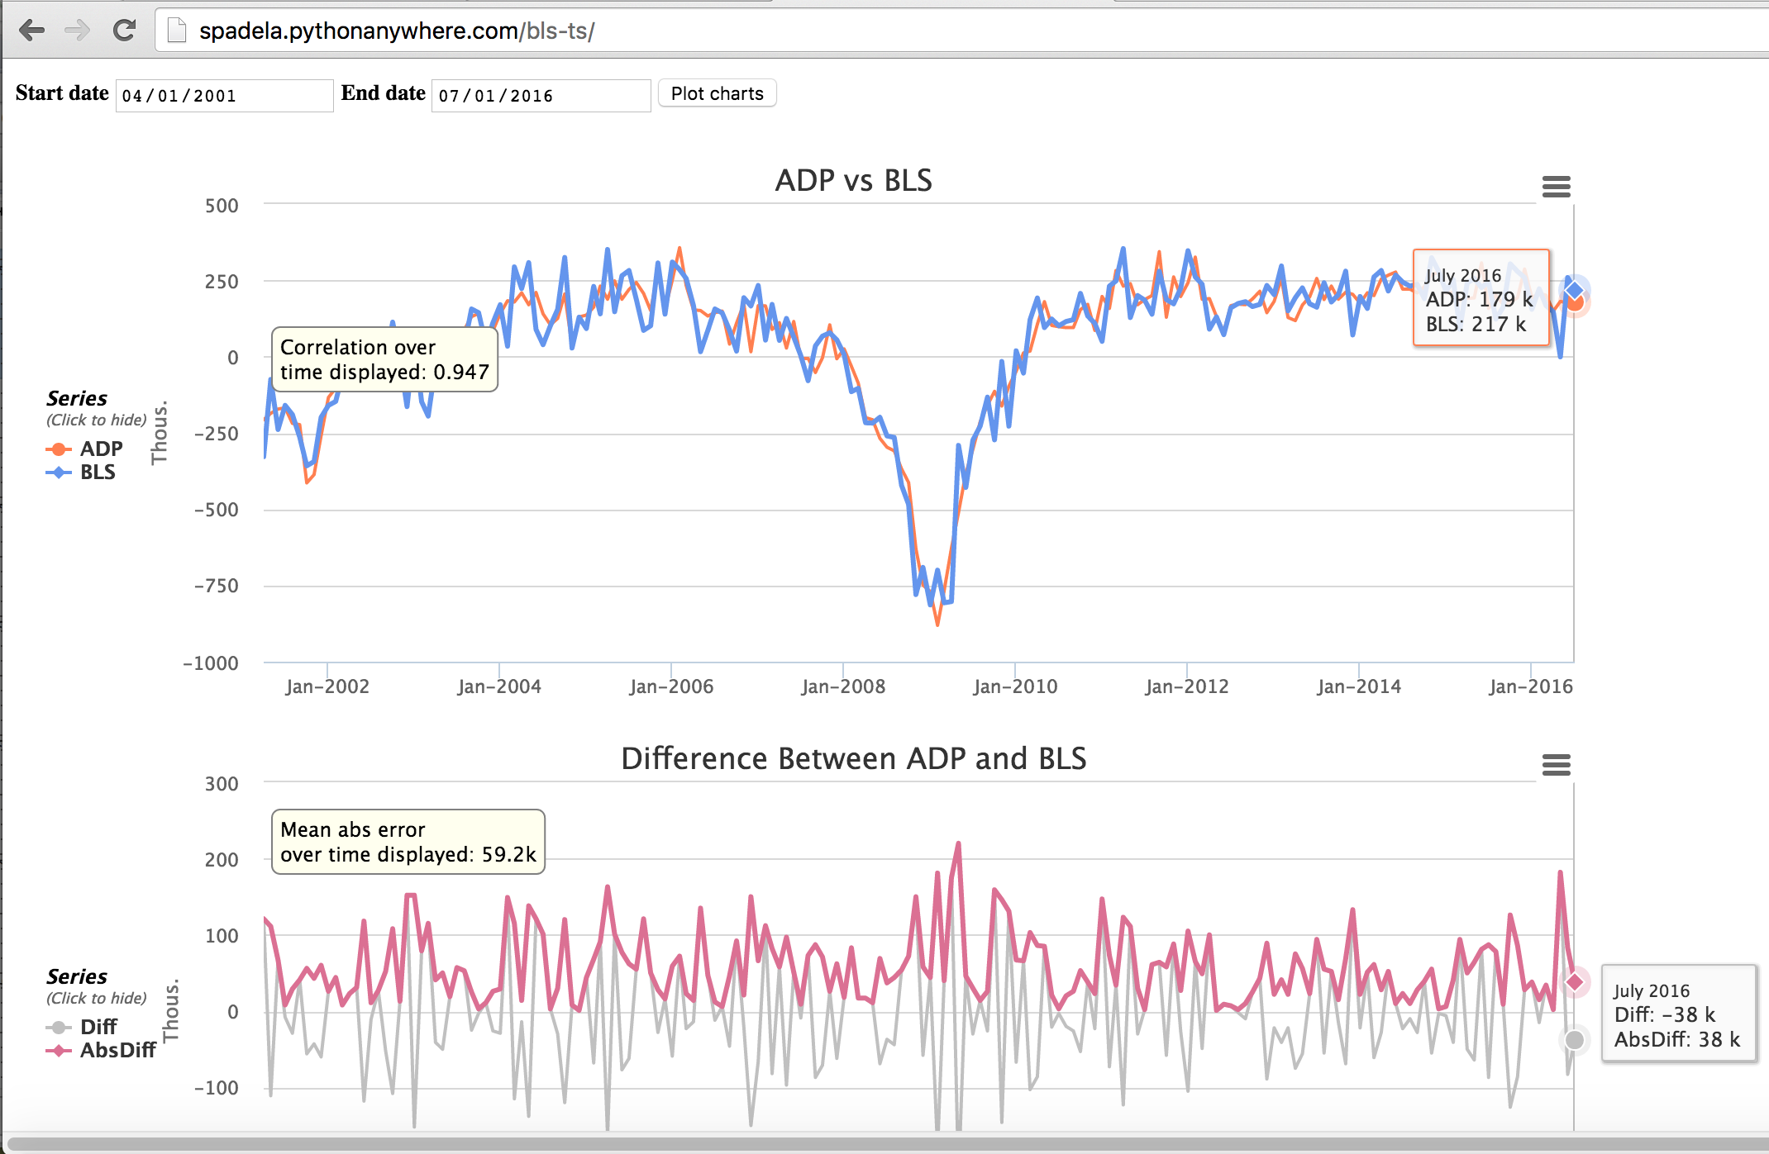
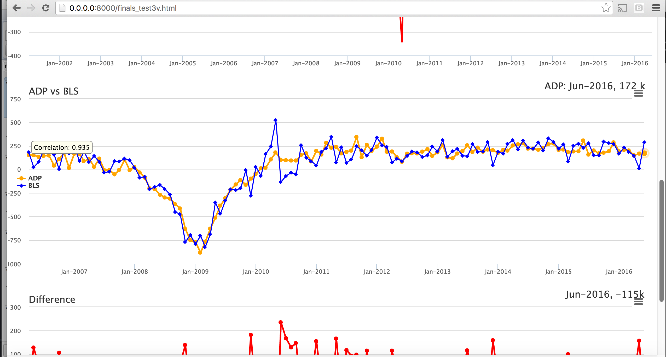
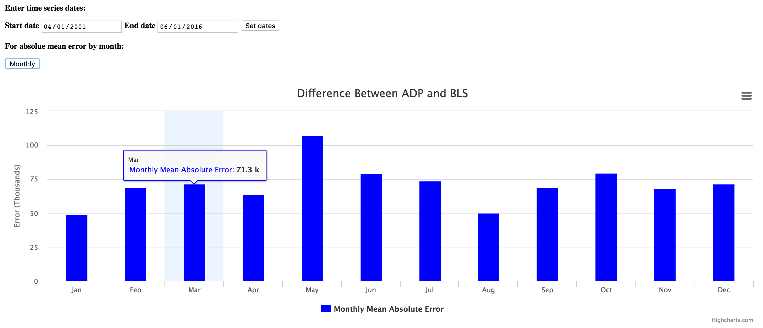
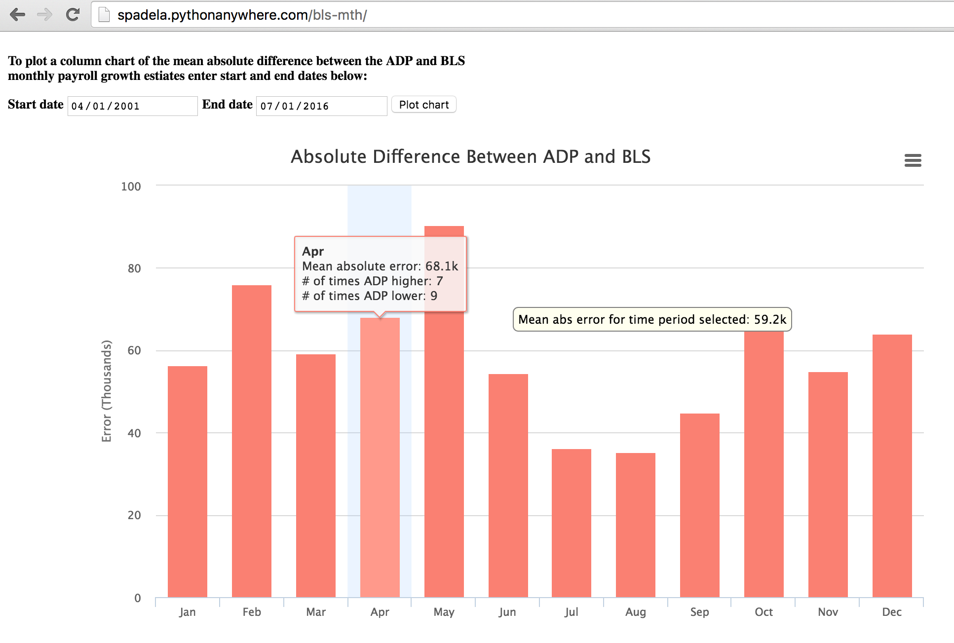
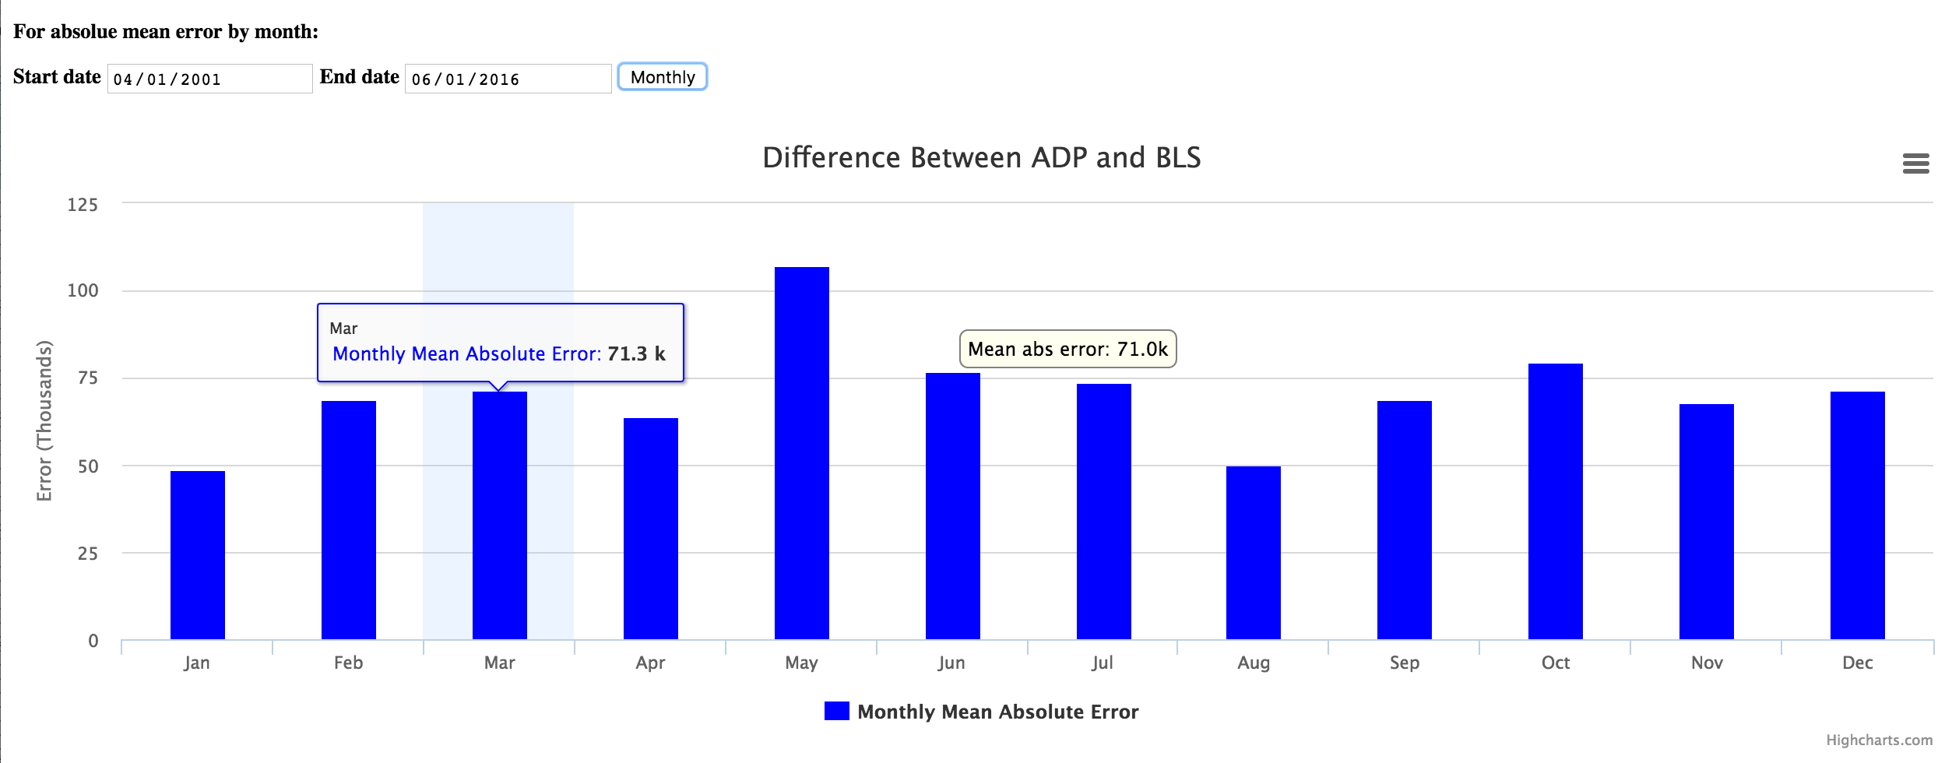
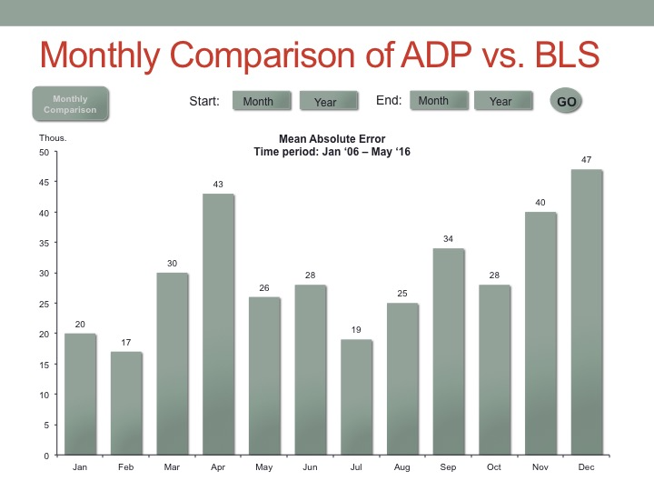
Based on user testing, we made multiple iterations on our visualizations (II) BLS Comparison
RR

Slide 14

Our updated visualization http://spadela.pythonanywhere.com/
Visualization
ADD IN A SCREENSHOT;
We will Switch over to the demo at this point

Slide 15
APPENDIX

Slide 16
Testing uncovered a number of potential changes to improve the user experience
UX Testing
AV / RR
Tool | Observation / Learning |  | Changes
Jobs Explorer | Lesson #1 |  | Add commentary Add Commentary
 | Lesson #2 |  | Add commentary Add Commentary
 | Lesson #2 |  | Add commentary Add Commentary
BLS Comparison | Lesson #1 |  | Add commentary Add Commentary
 | Lesson #2 |  | Add commentary Add Commentary
 | Lesson #3 |  | Add commentary Add Commentary

